Slide 1

HOUSE SALE PRICE PREDICTION
- SHALINI BARDHAN

Slide 2
AGENDA
INTRODUCTION
ABOUT DATASET
LINEAR REGRESSION

Slide 3

INTRODUCTION
The goal for this project was to use Linear Regression technique in order to estimate the sale price of a house for any particular city, given the features and pricing data for number of houses sold over a span of years.

Slide 4

ABOUT DATASET
- The dataset has been selected from the following link provided : https://github.com/insaid2018/Term-2/blob/master/Projects/houseprices.txt
- There are in total 1460 observations in the dataset.
- There are 80 total attributes in the dataset, out of which I have tried to use a handful few in this model; except for MsSubclass , zoning and etc. to name a few.

Slide 5
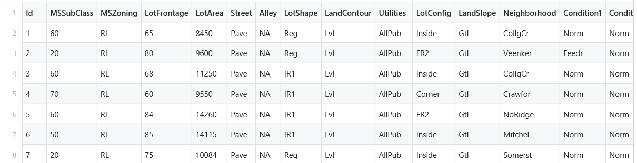
Glimpse of the Dataset
Displaying the first 7 rows of the dataset used as an example.

Slide 6
STATISTICAL APPROACH
- The statistical approach used here is Linear Regression technique.
What is Linear Regression?
Linear Regression is a linear approach to modelling the relationship between a response, i.e. a Dependent variable and one or more explanatory variables , i.e. an Independent variable.
While training the model we are given : x: input training data (univariate – one input variable(parameter)) y: labels to data (supervised learning)
When training the model – it fits the best line to predict the value of y for a given value of x. The model gets the best regression fit line by finding the best θ₁ and θ₂ values. θ₁: intercept θ₂: coefficient of x
Once we find the best θ₁ and θ₂ values, we get the best fit line. So when we are finally using our model for prediction, it will predict the value of y for the input value of x.

Slide 7
Linear Regression
EQUATION USED :
Given a data set
{ y i , x i 1 , … , x i p } ,for i = 1to n ; of n statistical units, a linear regression model assumes that the relationship between the dependent variable y and the p-vector of regressors x is linear. This relationship is modeled through a disturbance term or error variable ε — an unobserved random variable that adds "noise" to the linear relationship between the dependent variable and regressors. Thus the model takes the form
y i = β 0 1 + β 1 x i 1 + ⋯ + β p x i p + ε i = x(i^T)β + ε i , i = 1 , … , n ,
where T denotes the transpose, so that x(i^T)β is the inner product between vectors xi and β.

Slide 8
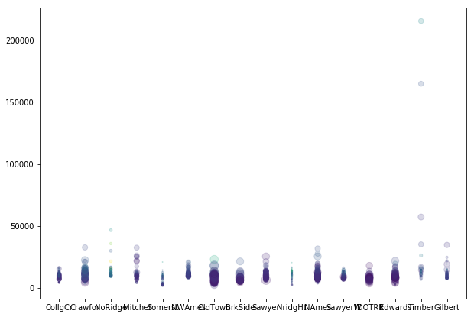
EXPLORATORY DATA ANALYSIS
- The exploratory data analysis involves the scatter plot output between the house sale price and the predictor variables.

Slide 9
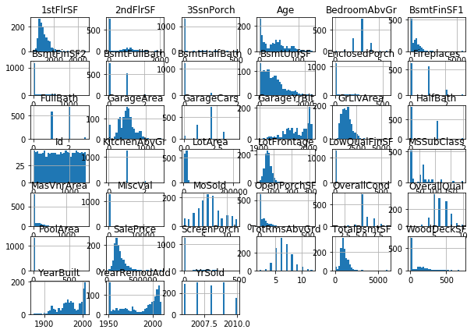
Here the histogram has been plotted to display the output between the dependent and independent variables/attributes.

Slide 10
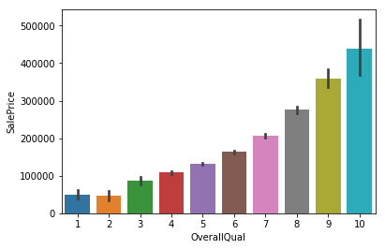
Plotted the output between the given Sale Price and the Over all quality of the houses using BAR PLOTS and BOX PLOTS.

Slide 11
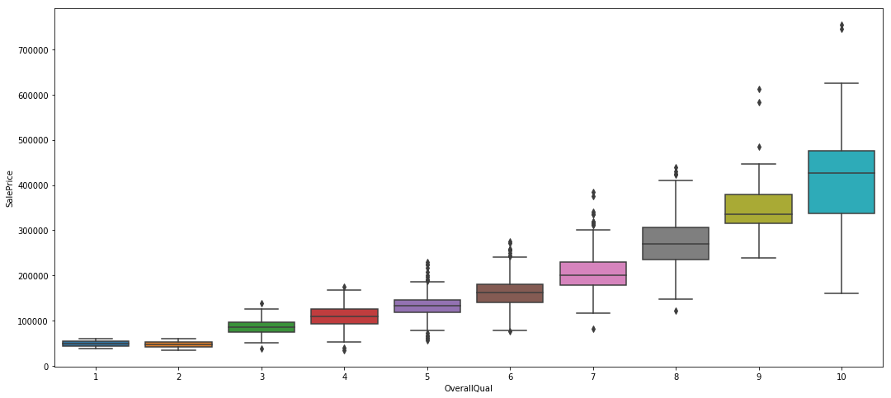

Slide 12

Model Evaluation METRIC
The Model Evaluation Metric used for this project is : ROOT MEAN SQUARE ERROR technique ( RMSE ) .
The RMSE is the square root of the variance of the residuals. It indicates the absolute fit of the model to the data–how close the observed data points are to the model's predicted values. RMSE is an absolute measure of fit.
P = Predicted value
O= Actual Value
N= Number of observation

Slide 13
Linear Regression ANALYTICS Results
TRAINING METRICS
TEST METRICS
From our training data set, using RMSE
We find out the SALES Price to be :
78032.94485454109
After fitting our data to the model , we calculate the SALES Price of the house;
Which evaluates to be approximately:
37600.03261237289

Slide 14
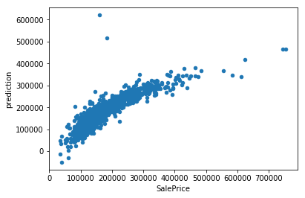
LINEAR REGRESSION PLOT between SALES PRICE and the PREDICTED PRICE

Slide 15
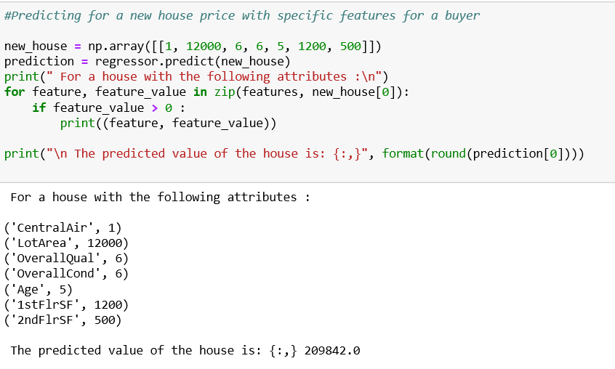
As our MODEL is accurate enough to proceed with; We have used it to predict the Sales Price of a new house with selective attributes/characteristics for a new buyer:

Slide 16
THE END

